Slide 1
Mining Data Streams
Note to other teachers and users of these slides: We would be delighted if you found this our material useful in giving your own lectures. Feel free to use these slides verbatim, or to modify them to fit your own needs. If you make use of a significant portion of these slides in your own lecture, please include this message, or a link to our web site: http://www.mmds.org
Adapted from Mining of Massive Datasets
Jure Leskovec, Anand Rajaraman, Jeff Ullman Stanford University
http://www.mmds.org

Slide 2
New Topic: Infinite Data
High dim. data
Locality sensitive hashing
Clustering
Graph data
PageRank, SimRank
Community Detection
Infinite data
Filtering data streams
Queries on streams
Dimensionality reduction
Spam Detection
Web advertising
Machine learning
SVM
Decision Trees
Perceptron, kNN
Apps
Recommender systems
Association Rules
Duplicate document detection

Slide 3
Data Streams
In many data mining situations, we do not know the entire data set in advance
Stream Management is important when the input rate is controlled externally:
Google queries
Twitter or Facebook status updates
We can think of the data as infinite and non-stationary (the distribution changes over time)

Slide 4
The Stream Model
Input elements enter at a rapid rate, at one or more input ports (i.e., streams)
We call elements of the stream tuples
The system cannot store the entire stream accessibly
Q: How do you make critical calculations about the stream using a limited amount of (secondary) memory?

Slide 5
Two types of queries
Adhoc Queries: Normal queries asked one time about the streams
Example: What is the maximum value seen so far in stream S?
Standing Queries: Queries that are, in principle, asked about the stream at all times.
Example: Report each new maximum value ever seen in stream S.

Slide 6
General Stream Processing Model /Data Stream Management System (DSMS)
Ad-Hoc
Queries
Processor
. . . 1, 5, 2, 7, 0, 9, 3
. . . a, r, v, t, y, h, b
. . . 0, 0, 1, 0, 1, 1, 0
time
Streams Entering.
Each stream is composed of elements/tuples
Standing
Queries
Output
Limited
Working
Storage
Archival
Storage

Slide 7
Problems on Data Streams
Sampling data from a stream
Construct a random sample
Queries over sliding windows
Number of items of type x in the last k elements of the stream
Filtering a data stream
Select elements with property x from the stream
Counting distinct elements
Number of distinct elements in the last k elements of the stream
Finding frequent elements

Slide 8
Applications (1)
Mining query streams
Google wants to know what queries are more frequent today than yesterday
Mining click streams
Yahoo wants to know which of its pages are getting an unusual number of hits in the past hour
Mining social network news feeds
E.g., look for trending topics on Twitter, Facebook

Slide 9
Applications (2)
Sensor Networks
Many sensors feeding into a central controller
Telephone call records
Data feeds into customer bills as well as settlements between telephone companies
IP packets monitored at a switch
Gather information for optimal routing
Detect denial-of-service attacks

Slide 10
Sampling from a Data Stream: Sampling a fixed proportion
As the stream grows the sample also gets bigger

Slide 11
Sampling from a Data Stream
Since we can not store the entire stream, one obvious approach is to store a sample
Two different problems:
(1) Sample a fixed proportion of elements in the stream (say 1 in 10)
(2) Maintain a random sample of fixed size over a potentially infinite stream
At any “time” k we would like a random sample of s elements
What is the property of the sample we want to maintain? For all time steps k, each of k elements seen so far has equal prob. of being sampled

Slide 12
Sampling a Fixed Proportion
Problem 1: Sampling fixed proportion
Scenario: Search engine query stream
Stream of tuples: (user, query, time)
Answer questions such as: How often did a user run the same query in a single days
Have space to store 1/10th of query stream
Naïve solution:
Generate a random integer in [0..9] for each query
Store the query if the integer is 0, otherwise discard

Slide 13
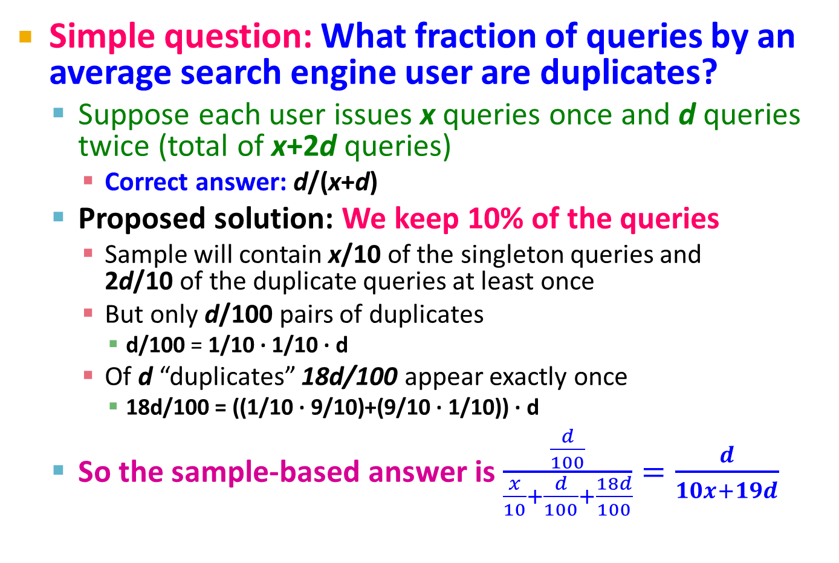
Problem with Naïve Approach
Simple question: What fraction of queries by an average search engine user are duplicates?
Suppose each user issues x queries once and d queries twice (total of x+2d queries)
Correct answer: d/(x+d)
Proposed solution: We keep 10% of the queries
Sample will contain x/10 of the singleton queries and 2d/10 of the duplicate queries at least once
But only d/100 pairs of duplicates
d/100 = 1/10 ∙ 1/10 ∙ d
Of d “duplicates” 18d/100 appear exactly once
18d/100 = ((1/10 ∙ 9/10)+(9/10 ∙ 1/10)) ∙ d
So the sample-based answer is $\frac{\frac{d}{100}}{\frac{x}{10}+\frac{d}{100}+\frac{18d}{100}}=\frac{d}{10x+19d}$
Notes:
d/100 appear twitece: 1st query gets sampled with prob. 1/10, 2nd also with 1/10, there are d such queries: d/100
18d/100 appear once. 1/10 for first to get selection and 9/10 for the second to not get selected. And the other way around so 18d/100

Slide 14
Solution: Sample Users
Solution:
Pick 1/10th of users and take all their searches in the sample
Use a hash function that hashes the user name or user id uniformly into 10 buckets

Slide 15
Sampling from a Data Stream: Sampling a fixed-size sample
As the stream grows, the sample is of fixed size

Slide 16
Maintaining a fixed-size sample
Problem 2: Fixed-size sample
Suppose we need to maintain a random sample S of size exactly s tuples
Main memory size constraint
Don’t know length of stream in advance
Suppose at time n we have seen n items
Each item is in the sample S with equal prob. s/n
How to think about the problem: say s = 2
Stream: a x c y z k c d e g…
At n= 5, each of the first 5 tuples is included in the sample S with equal prob.
At n= 7, each of the first 7 tuples is included in the sample S with equal prob.
Impractical solution would be to store all the n tuples seen so far and out of them pick s at random

Slide 17
Solution: Fixed Size Sample
Algorithm (a.k.a. Reservoir Sampling)
Store all the first s elements of the stream to S
Suppose we have seen n-1 elements, and now the n^{th} element arrives (n > s)
With probability s/n, keep the n^{th} element, else discard it
If we picked the n^{th} element, then it replaces one of the s elements in the sample S, picked uniformly at random
Claim: This algorithm maintains a sample S with the desired property:
After n elements, the sample contains each element seen so far with probability s/n

Slide 18
Proof: By Induction
We prove this by induction:
Assume that after n elements, the sample contains each element seen so far with probability s/n
We need to show that after seeing element n+1 the sample maintains the property
Sample contains each element seen so far with probability s/(n+1)
Base case:
After we see n=s elements the sample S has the desired property
Each out of n=s elements is in the sample with probability s/s = 1

Slide 19
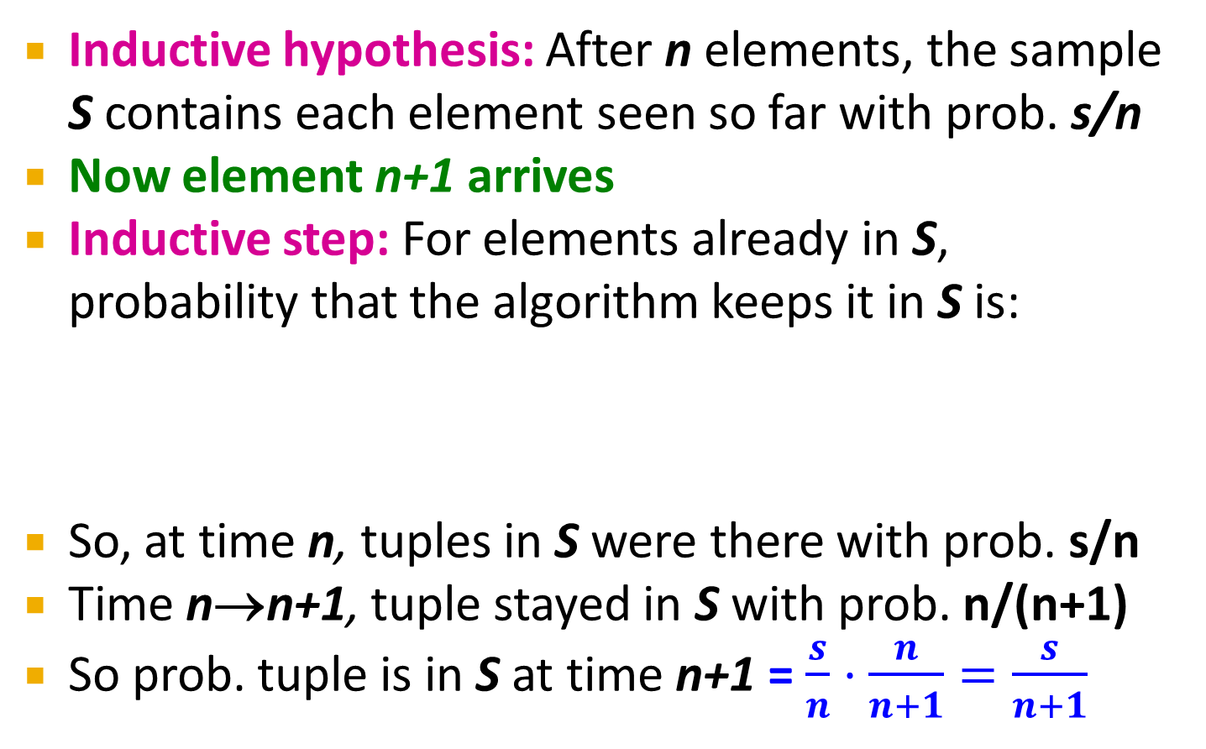
Proof: By Induction
Inductive hypothesis: After n elements, the sample S contains each element seen so far with prob. s/n
Now element n+1 arrives
Inductive step: For elements already in S, probability that the algorithm keeps it in S is:
So, at time n, tuples in S were there with prob. s/n
Time n→n+1, tuple stayed in S with prob. n/(n+1)
So prob. tuple is in S at time n+1 = $\frac{s}{n}⋅\frac{n}{n+1}=\frac{s}{n+1}$
Element n+1 discarded
Element n+1 not discarded
Element in the sample not picked

Slide 20
Queries over a (long) Sliding Window

Slide 21
Sliding Windows
A useful model of stream processing is that queries are about a window of length N – the N most recent elements received
Interesting case: N is so large that the data cannot be stored in memory, or even on disk
Or, there are so many streams that windows for all cannot be stored
Amazon example:
For every product X we keep 0/1 stream of whether that product was sold in the n-th transaction
We want answer queries, how many times have we sold X in the last k sales

Slide 22
Sliding Window: 1 Stream
Sliding window on a single stream:
N = 6
q w e r t y u i o p a s d f g h j k l z x c v b n m
q w e r t y u i o p a s d f g h j k l z x c v b n m
q w e r t y u i o p a s d f g h j k l z x c v b n m
q w e r t y u i o p a s d f g h j k l z x c v b n m
Past Future

Slide 23
Counting Bits (1)
Problem:
Given a stream of 0s and 1s
Be prepared to answer queries of the form How many 1s are in the last k bits? where k ≤ N
Obvious solution: Store the most recent N bits
When new bit comes in, discard the N+1st bit
0 1 0 0 1 1 0 1 1 1 0 1 0 1 0 1 1 0 1 1 0 1 1 0
Suppose N=6
Past Future

Slide 24
Counting Bits (2)
You can not get an exact answer without storing the entire window
Real Problem: What if we cannot afford to store N bits?
E.g., we’re processing 1 billion streams and N = 1 billion
But we are happy with an approximate answer
0 1 0 0 1 1 0 1 1 1 0 1 0 1 0 1 1 0 1 1 0 1 1 0
Past Future

Slide 25
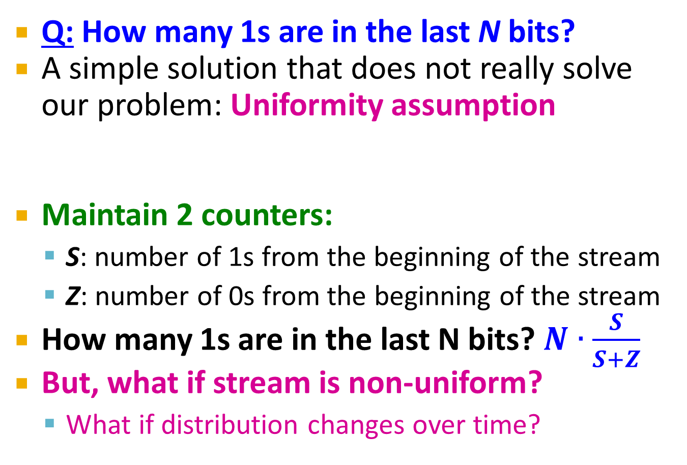
An attempt: Simple solution
Q: How many 1s are in the last N bits?
A simple solution that does not really solve our problem: Uniformity assumption
Maintain 2 counters:
S: number of 1s from the beginning of the stream
Z: number of 0s from the beginning of the stream
How many 1s are in the last N bits? $N∙\frac{S}{S+Z}$
But, what if stream is non-uniform?
What if distribution changes over time?
N
0 1 0 0 1 1 1 0 0 0 1 0 1 0 0 1 0 0 0 1 0 1 1 0 1 1 0 1 1 1 0 0 1 0 1 0 1 1 0 0 1 1 0 1 0
Past Future

Slide 26
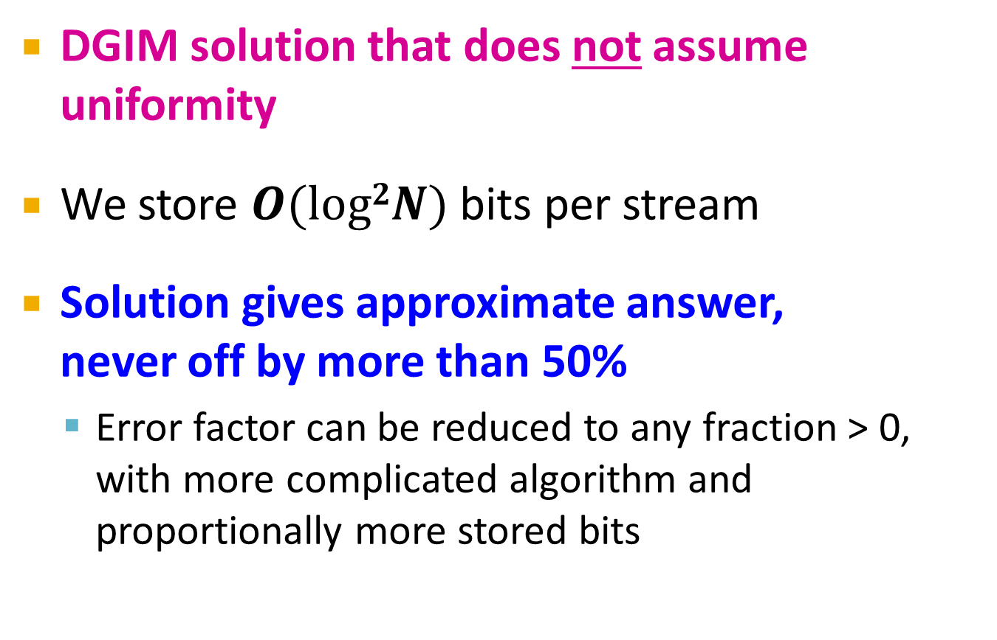
DGIM Method
[Datar, Gionis, Indyk, Motwani]
DGIM solution that does not assume uniformity
We store $O(log2N)$ bits per stream
Solution gives approximate answer, never off by more than 50%
Error factor can be reduced to any fraction > 0, with more complicated algorithm and proportionally more stored bits

Slide 27
Idea: Exponential Windows
Solution that doesn’t (quite) work:
Summarize exponentially increasing regions of the stream, looking backward
Drop small regions if they begin at the same point as a larger region
Window of width 16 has 6 1s
6
10
?
4
3
2
2
1
1
0
0 1 0 0 1 1 1 0 0 0 1 0 1 0 0 1 0 0 0 1 0 1 1 0 1 1 0 1 1 1 0 0 1 0 1 0 1 1 0 0 1 1 0 1 0
N
We can reconstruct the count of the last N bits, except we are not sure how many of the last 6 1s are included in the N
Notes:
remember -- this is a strawman algorithm that doesn't really work, so I never spent much time worrying about it, and you shouldn't either. However, you don't have to worry about where the buckets begin or end in this algorithm, since that is determined completely from the count of bits received so far. The rule for updating is as follows. 1. when a bit comes in, create a bucket of length 1 with the proper count (0 or 1). 2. If any level has 3 buckets: a) add the rightmost two and create a bucket at the next higher level (twice the length) with that sum. b) delete the leftmost two buckets, keeping only the rightmost of the three.. 3. Repeat (2) recursively for progressively higher levels. I hope this helps. I would really invite students to figure it out if they care (they won't).

Slide 28
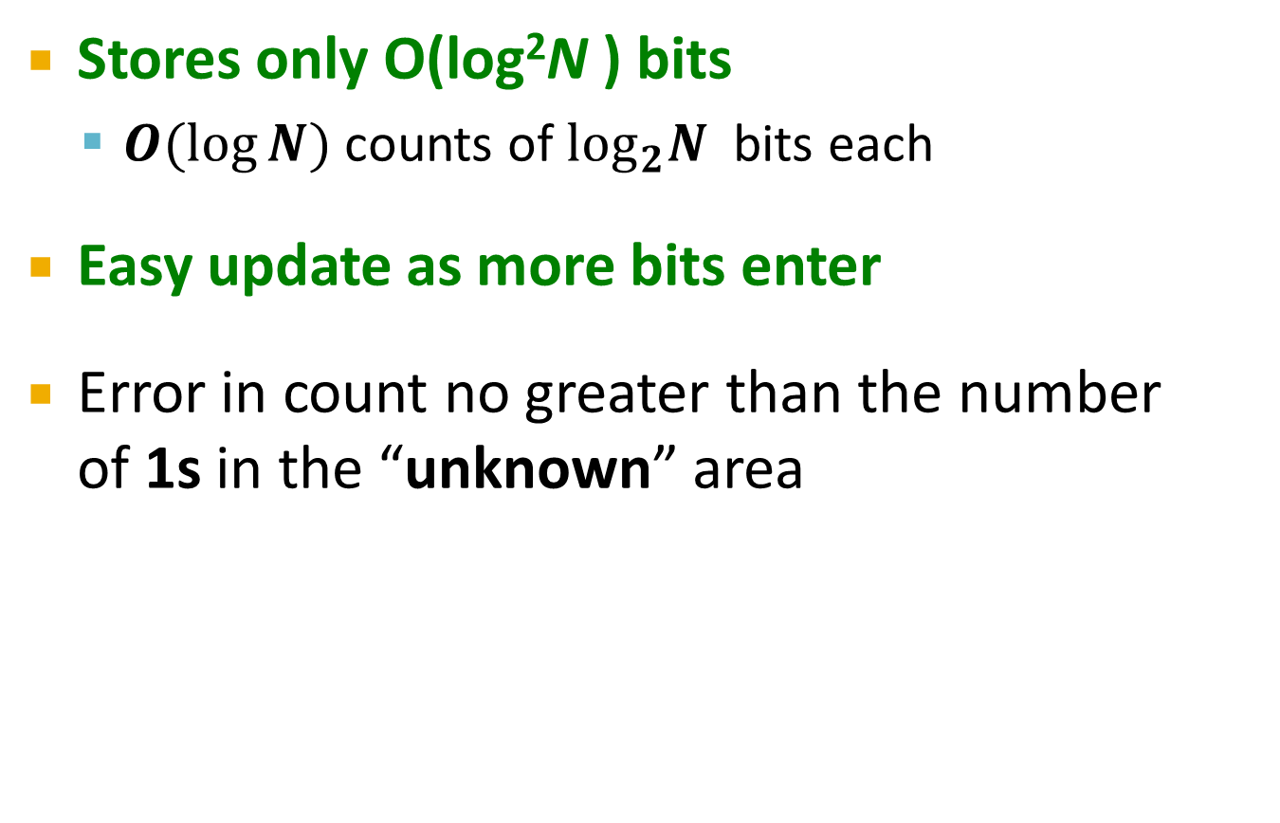
What’s Good?
Stores only O(log²N ) bits
$O(log⁡N)$ counts of $\log_{2}N$ bits each
Easy update as more bits enter
Error in count no greater than the number of 1s in the “unknown” area

Slide 29
What’s Not So Good?
As long as the 1s are fairly evenly distributed, the error due to the unknown region is small – no more than 50%
But it could be that all the 1s are in the unknown area at the end
In that case, the error is unbounded!
6
10
?
4
3
2
2
1
1
0
0 1 0 0 1 1 1 0 0 0 1 0 1 0 0 1 0 0 0 1 0 1 1 0 1 1 0 1 1 1 0 0 1 0 1 0 1 1 0 0 1 1 0 1 0
N

Slide 30
Fixup: DGIM method
[Datar, Gionis, Indyk, Motwani]
Idea: Instead of summarizing fixed-length blocks, summarize blocks with specific number of 1s:
Let the block sizes (number of 1s) increase exponentially
When there are few 1s in the window, block sizes stay small, so errors are small
1001010110001011010101010101011010101010101110101010111010100010110010
N

Slide 31
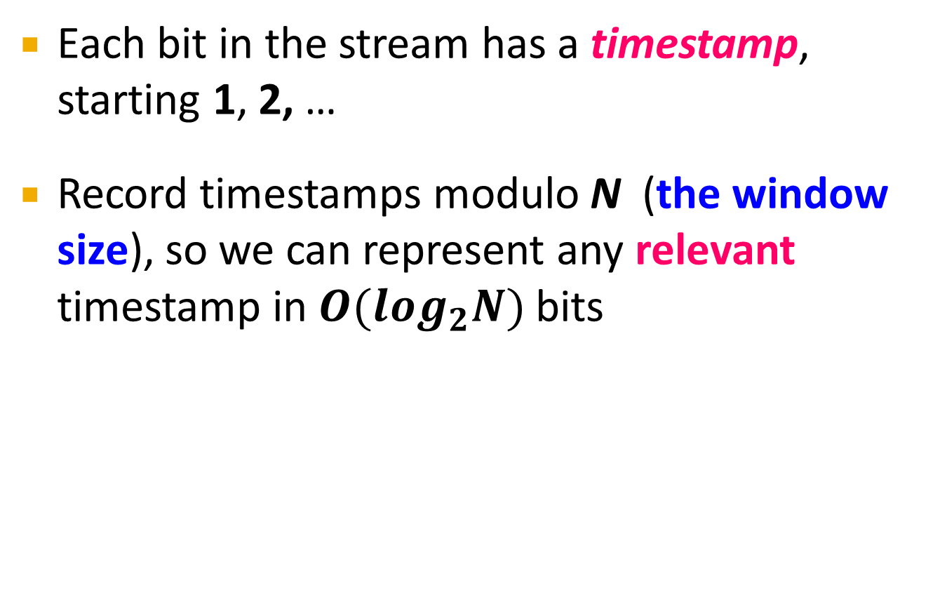
DGIM: Timestamps
Each bit in the stream has a timestamp, starting 1, 2, …
Record timestamps modulo N (the window size), so we can represent any relevant timestamp in $O(log_{2}N)$ bits

Slide 32
DGIM: Buckets
A bucket in the DGIM method is a record consisting of:
(A) The timestamp of its end [O(log N) bits]
(B) The number of 1s between its beginning and end [O(log log N) bits]
Constraint on buckets: Number of 1s must be a power of 2
That explains the O(log log N) in (B) above
1001010110001011010101010101011010101010101110101010111010100010110010
N

Slide 33
Representing a Stream by Buckets
Either one or two buckets with the same power-of-2 number of 1s
Buckets do not overlap in timestamps
Buckets are sorted by size
Earlier buckets are not smaller than later buckets
Buckets disappear when their end-time is > N time units in the past

Slide 34
Example: Bucketized Stream
At least 1 of
size 16. Partially
beyond window.
2 of
size 8
2 of
size 4
1 of
size 2
2 of
size 1
1001010110001011010101010101011010101010101110101010111010100010110010
N
Three properties of buckets that are maintained:
- Either one or two buckets with the same power-of-2 number of 1s
- Buckets do not overlap in timestamps
- Buckets are sorted by size

Slide 35
Updating Buckets (1)
When a new bit comes in, drop the last (oldest) bucket if its end-time is prior to N time units before the current time
2 cases: Current bit is 0 or 1
If the current bit is 0: no other changes are needed

Slide 36
Updating Buckets (2)
If the current bit is 1:
(1) Create a new bucket of size 1, for just this bit
End timestamp = current time
(2) If there are now three buckets of size 1, combine the oldest two into a bucket of size 2
(3) If there are now three buckets of size 2, combine the oldest two into a bucket of size 4
(4) And so on …

Slide 37
Example: Updating Buckets
Current state of the stream:
1001010110001011010101010101011010101010101110101010111010100010110010
Bit of value 1 arrives
0010101100010110101010101010110101010101011101010101110101000101100101
Two orange buckets get merged into a yellow bucket
0010101100010110101010101010110101010101011101010101110101000101100101
Next bit 1 arrives, new orange bucket is created, then 0 comes, then 1:
0101100010110101010101010110101010101011101010101110101000101100101101
Buckets get merged…
0101100010110101010101010110101010101011101010101110101000101100101101
State of the buckets after merging
0101100010110101010101010110101010101011101010101110101000101100101101

Slide 38
How to Query?
To estimate the number of 1s in the most recent N bits:
Sum the sizes of all buckets but the last
(note “size” means the number of 1s in the bucket)
Add half the size of the last bucket
Remember: We do not know how many 1s of the last bucket are still within the wanted window

Slide 39
Example: Bucketized Stream
At least 1 of
size 16. Partially
beyond window.
2 of
size 8
2 of
size 4
1 of
size 2
2 of
size 1
1001010110001011010101010101011010101010101110101010111010100010110010
N

Slide 40
Error Bound: Proof
Why is error 50%? Let’s prove it!
Suppose the last bucket has size 2^{r}
Then by assuming 2^{r-1} (i.e., half) of its 1s are still within the window, we make an error of at most 2^{r-1}
Since there is at least one bucket of each of the sizes less than 2^{r}, the true sum is at least 1 + 2 + 4 + .. + 2^{r-1} = 2^{r} -1
Thus, error at most 50%
At least 16 1s
111111110000000011101010101011010101010101110101010111010100010110010
N

Slide 41
(1) Filtering Data Streams

Slide 42
Filtering Data Streams
Each element of data stream is a tuple
Given a list of keys S
Determine which tuples of stream are in S
Obvious solution: Hash table
But suppose we do not have enough memory to store all of S in a hash table
E.g., we might be processing millions of filters on the same stream

Slide 43
Applications
Example: Email spam filtering
We know 1 billion “good” email addresses
If an email comes from one of these, it is NOT spam
Publish-subscribe systems
You are collecting lots of messages (news articles)
People express interest in certain sets of keywords
Determine whether each message matches user’s interest

Slide 44
First Cut Solution (1)
Given a set of keys S that we want to filter
Create a bit array B of n bits, initially all 0s
Choose a hash function h with range [0,n)
Hash each member of s∈ S to one of n buckets, and set that bit to 1, i.e., B[h(s)]=1
Hash each element a of the stream and output only those that hash to bit that was set to 1
Output a if B[h(a)] == 1

Slide 45
First Cut Solution (2)
Output the item since it may be in S.
Item hashes to a bucket that at least one of the items in S hashed to.
Filter
Item
Hash func h
0010001011000
Bit array B
Drop the item.
It hashes to a bucket set to 0 so it is surely not in S.
Creates false positives but no false negatives
If the item is in S we surely output it, if not we may still output it

Slide 46
First Cut Solution (3)
|S| = 1 billion email addresses |B|= 1GB = 8 billion bits
If the email address is in S, then it surely hashes to a bucket that has the big set to 1, so it always gets through (no false negatives)
Approximately 1/8 of the bits are set to 1, so about 1/8th of the addresses not in S get through to the output (false positives)
Actually, less than 1/8th, because more than one address might hash to the same bit

Slide 47
Analysis: Throwing Darts (1)
More accurate analysis for the number of false positives
Consider: If we throw m darts into n equally likely targets, what is the probability that a target gets at least one dart?
In our case:
Targets = bits/buckets
Darts = hash values of items

Slide 48
Analysis: Throwing Darts (2)
We have m darts, n targets
What is the probability that a target gets at least one dart?
Equals 1/e
as n →∞
Equivalent
n(
m
/ n)
1 -
(1 – 1/n)
1 – e^{–m/n}
Probability some
target X not hit
by a dart
Probability at
least one dart
hits target X

Slide 49
Analysis: Throwing Darts (3)
Fraction of 1s in the array B = = probability of false positive = 1 – e^{-m/n}
Example: 10⁹ darts, 8∙10⁹ targets
Fraction of 1s in B = 1 – e^{-1/8} = 0.1175
Compare with our earlier estimate: 1/8 = 0.125

Slide 50
Bloom Filter
Consider: |S| = m, |B| = n
Use k independent hash functions h₁ ,…, h_{k}
Initialization:
Set B to all 0s
Hash each element s∈ S using each hash function h_{i}, set B[h_{i}(s)] = 1 (for each i = 1,.., k)
Run-time:
When a stream element with key x arrives
If B[h_{i}(x)] = 1 for all i = 1,..., k then declare that x is in S
That is, x hashes to a bucket set to 1 for every hash function h_{i}(x)
Otherwise discard the element x
(note: we have a single array B!)

Slide 51
Bloom Filter -- Analysis
What fraction of the bit vector B are 1s?
Throwing k∙m darts at n targets
So fraction of 1s is (1 – e^{-km/n})
But we have k independent hash functions and we only let the element x through if all k hash element x to a bucket of value 1
So, false positive probability = (1 – e^{-km/n})^{k}

Slide 52
Bloom Filter – Analysis (2)
m = 1 billion, n = 8 billion
k = 1: (1 – e^{-1/8}) = 0.1175
k = 2: (1 – e^{-1/4})² = 0.0493
What happens as we keep increasing k?
“Optimal” value of k: n/m ln(2)
In our case: Optimal k = 8 ln(2) = 5.54 ≈ 6
Error at k = 6: (1 – e^{-6/8})⁶ = 0.02158
False positive prob.
Number of hash functions, k

Slide 53
Bloom Filter: Wrap-up
Bloom filters guarantee no false negatives, and use limited memory
Great for pre-processing before more expensive checks
Suitable for hardware implementation
Hash function computations can be parallelized
Is it better to have 1 big B or k small Bs?
It is the same: (1 – e^{-km/n})^{k} vs. (1 – e^{-m/(n/k)})^{k}
But keeping 1 big B is simpler

Slide 54
(2) Counting Distinct Elements

Slide 55
Counting Distinct Elements
Problem:
Data stream consists of a universe of elements chosen from a set of size N
Maintain a count of the number of distinct elements seen so far
Obvious approach: Maintain the set of elements seen so far
That is, keep a hash table of all the distinct elements seen so far

Slide 56
Applications
How many different words are found among the Web pages being crawled at a site?
Unusually low or high numbers could indicate artificial pages (spam?)
How many different Web pages does each customer request in a week?
How many distinct products have we sold in the last week?

Slide 57
Using Small Storage
Real problem: What if we do not have space to maintain the set of elements seen so far?
Estimate the count in an unbiased way
Accept that the count may have a little error, but limit the probability that the error is large

Slide 58
Flajolet-Martin Approach
Pick a hash function h that maps each of the N elements to at least log₂ N bits
For each stream element a, let r(a) be the number of trailing 0s in h(a)
r(a) = position of first 1 counting from the right
E.g., say h(a) = 12, then 12 is 1100 in binary, so r(a) = 2
Record R = the maximum r(a) seen
R = max_{a} r(a), over all the items a seen so far
Estimated number of distinct elements = 2^{R}

Slide 59
Why It Works: Intuition
Very very rough and heuristic intuition why Flajolet-Martin works:
h(a) hashes a with equal prob. to any of N values
Then h(a) is a sequence of log₂ N bits, where 2^{-r} fraction of all as have a tail of r zeros
About 50% of as hash to ***0
About 25% of as hash to **00
So, if we saw the longest tail of r=2 (i.e., item hash ending *100) then we have probably seen about 4 distinct items so far
So, it takes to hash about 2^{r} items before we see one with zero-suffix of length r

Slide 60
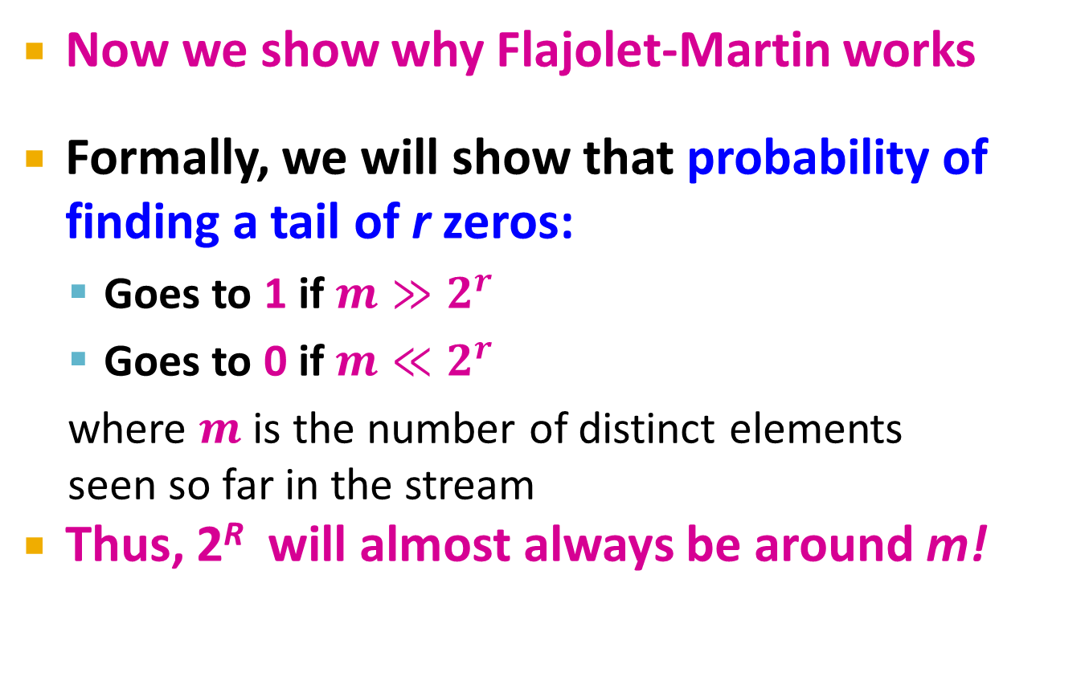
Why It Works: More formally
Now we show why Flajolet-Martin works
Formally, we will show that probability of finding a tail of r zeros:
Goes to 1 if $m≫2^{r}$
Goes to 0 if $m≪2^{r}$
where $m$ is the number of distinct elements seen so far in the stream
Thus, 2^{R} will almost always be around m!

Slide 61
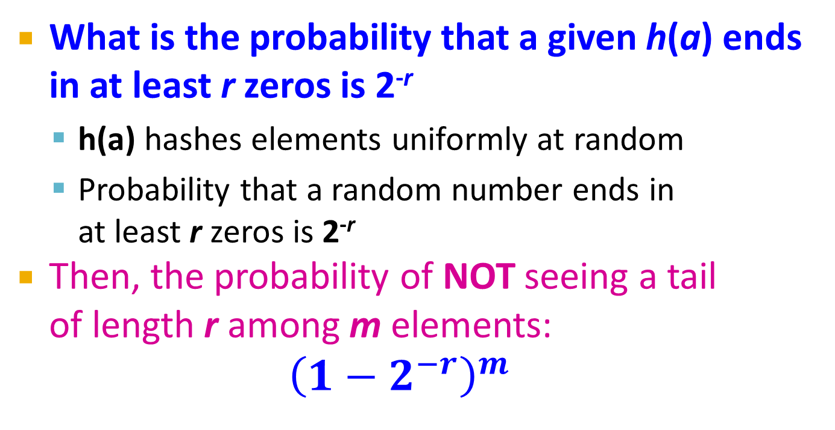
Why It Works: More formally
What is the probability that a given h(a) ends in at least r zeros is 2^{-r}
h(a) hashes elements uniformly at random
Probability that a random number ends in at least r zeros is 2^{-r}
Then, the probability of NOT seeing a tail of length r among m elements:
$${\left(1−2^{−r}\right)}^{m}$$
Prob. all end in fewer than r zeros.
Prob. that given h(a) ends in fewer than r zeros

Slide 62
Why It Works: More formally
Note:
Prob. of NOT finding a tail of length r is:
If m << 2^{r}, then prob. tends to 1
as m/2^{r}→ 0
So, the probability of finding a tail of length r tends to 0
If m >> 2^{r}, then prob. tends to 0
as m/2^{r} → ∞
So, the probability of finding a tail of length r tends to 1
Thus, 2^{R} will almost always be around m!

Slide 63
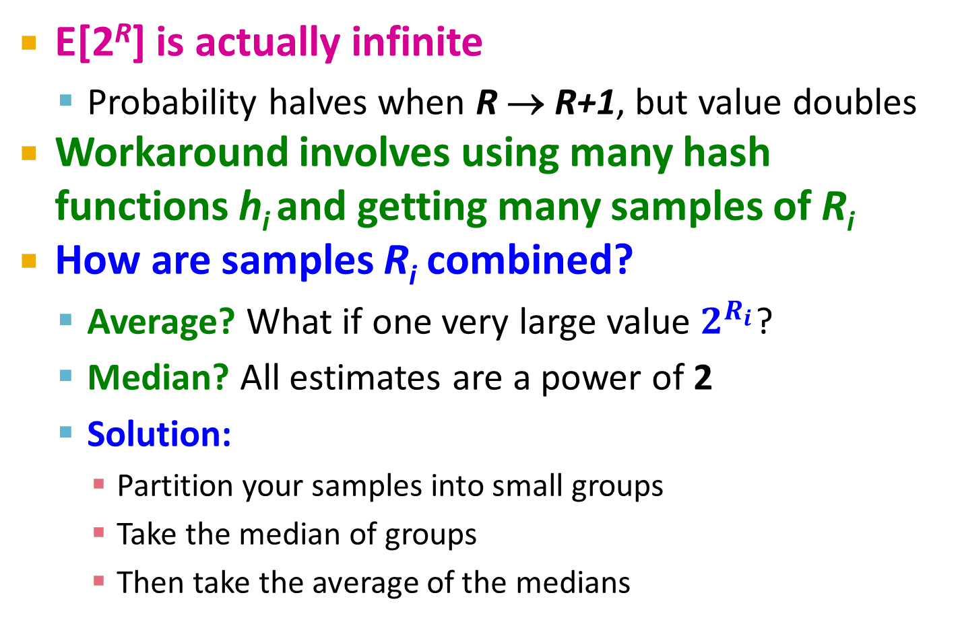
Why It Doesn’t Work
E[2^{R}] is actually infinite
Probability halves when R → R+1, but value doubles
Workaround involves using many hash functions h_{i} and getting many samples of R_{i}
How are samples R_{i} combined?
Average? What if one very large value $2^{R_{i}}$?
Median? All estimates are a power of 2
Solution:
Partition your samples into small groups
Take the median of groups
Then take the average of the medians

